Slide 1
ONBOARDING

Slide 2
Hardware
Pico Neo 3 Pro
Before you start
In the box
Play boundaries
Disable play boundaries
Connect wifi
Software
Showroom (VR)
Controllers
Screen cast
Activate Developer Mode
Reinstall
Setup kiosk mode
Vr Salud APP
Controls

Slide 3
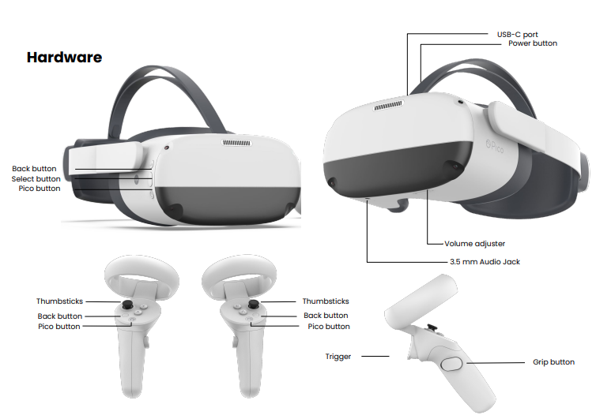
Before you start
In the box
Do not allow the lenses to come in contact with long periods of direct sunlight. This will permanently damage the screen and does not fall under warranty.
Make sure you have enough room space to move around.
Battery status: to check battery status, you can rely to the led near to power button, o press pico button and check battery level.
1 x Pico Neo 3
2 x Pico Neo 3 controller
2 x Lanyard
1 x Charging Cable
1 x Wall Charger
1 x Cleaning Cloth

Slide 4
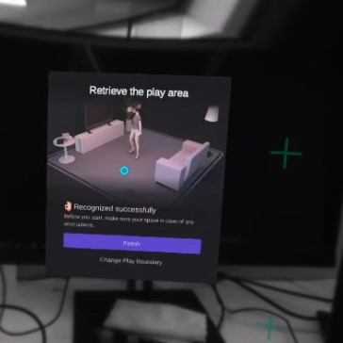
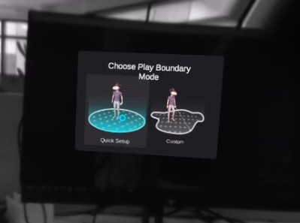
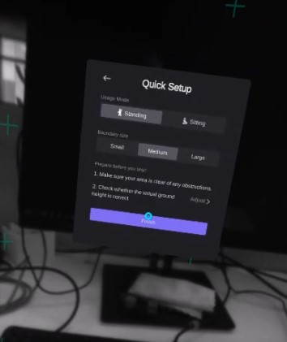
Play boundaries
1. Turn on with power button fig1
2. The first you see is the setup of play boundaries to set the VR environment match the physical one. With you controller and the trigger button you can select items in the menu.
NOTE: If ia warning shows up, press trigger or confirm button.
Quick setup and medium standing is recommended. In option 2. you can adjust floor level to be more precise

Slide 5
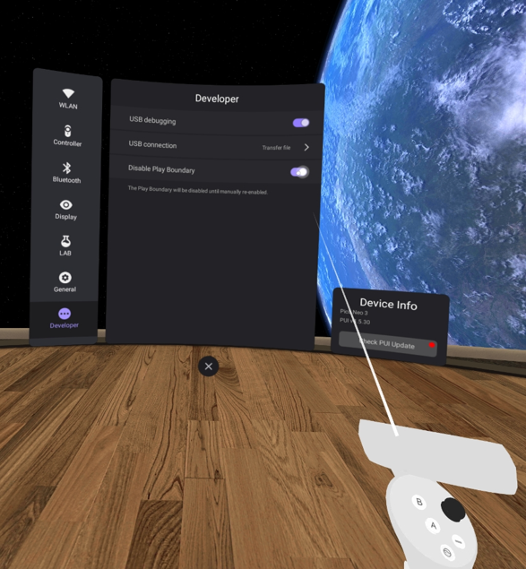
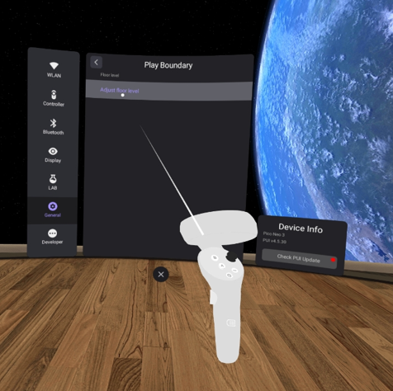
Disable play boundaries
You can disable the play boundary configuration to make more quick the application initialization.
Pico button -> three dots -> general -> developer
Once you disable play boundaries you can also adjust the floor level.

Slide 6
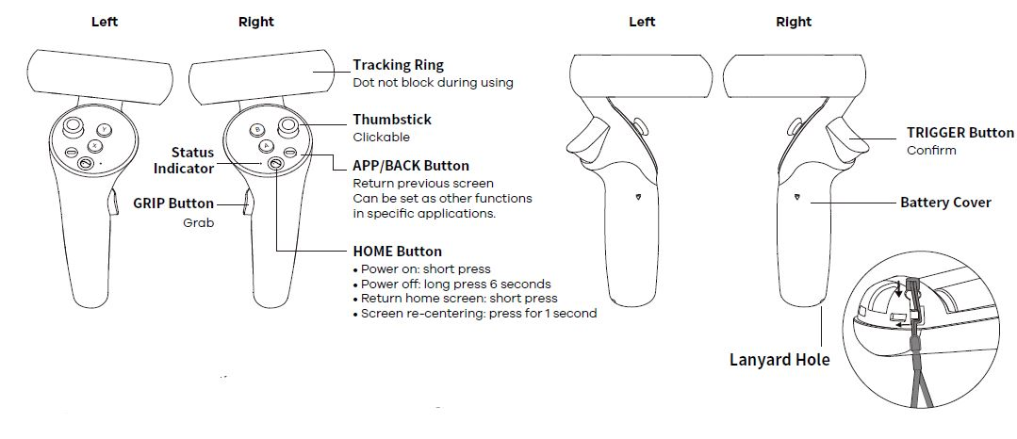
VR APP Controllers

Slide 7
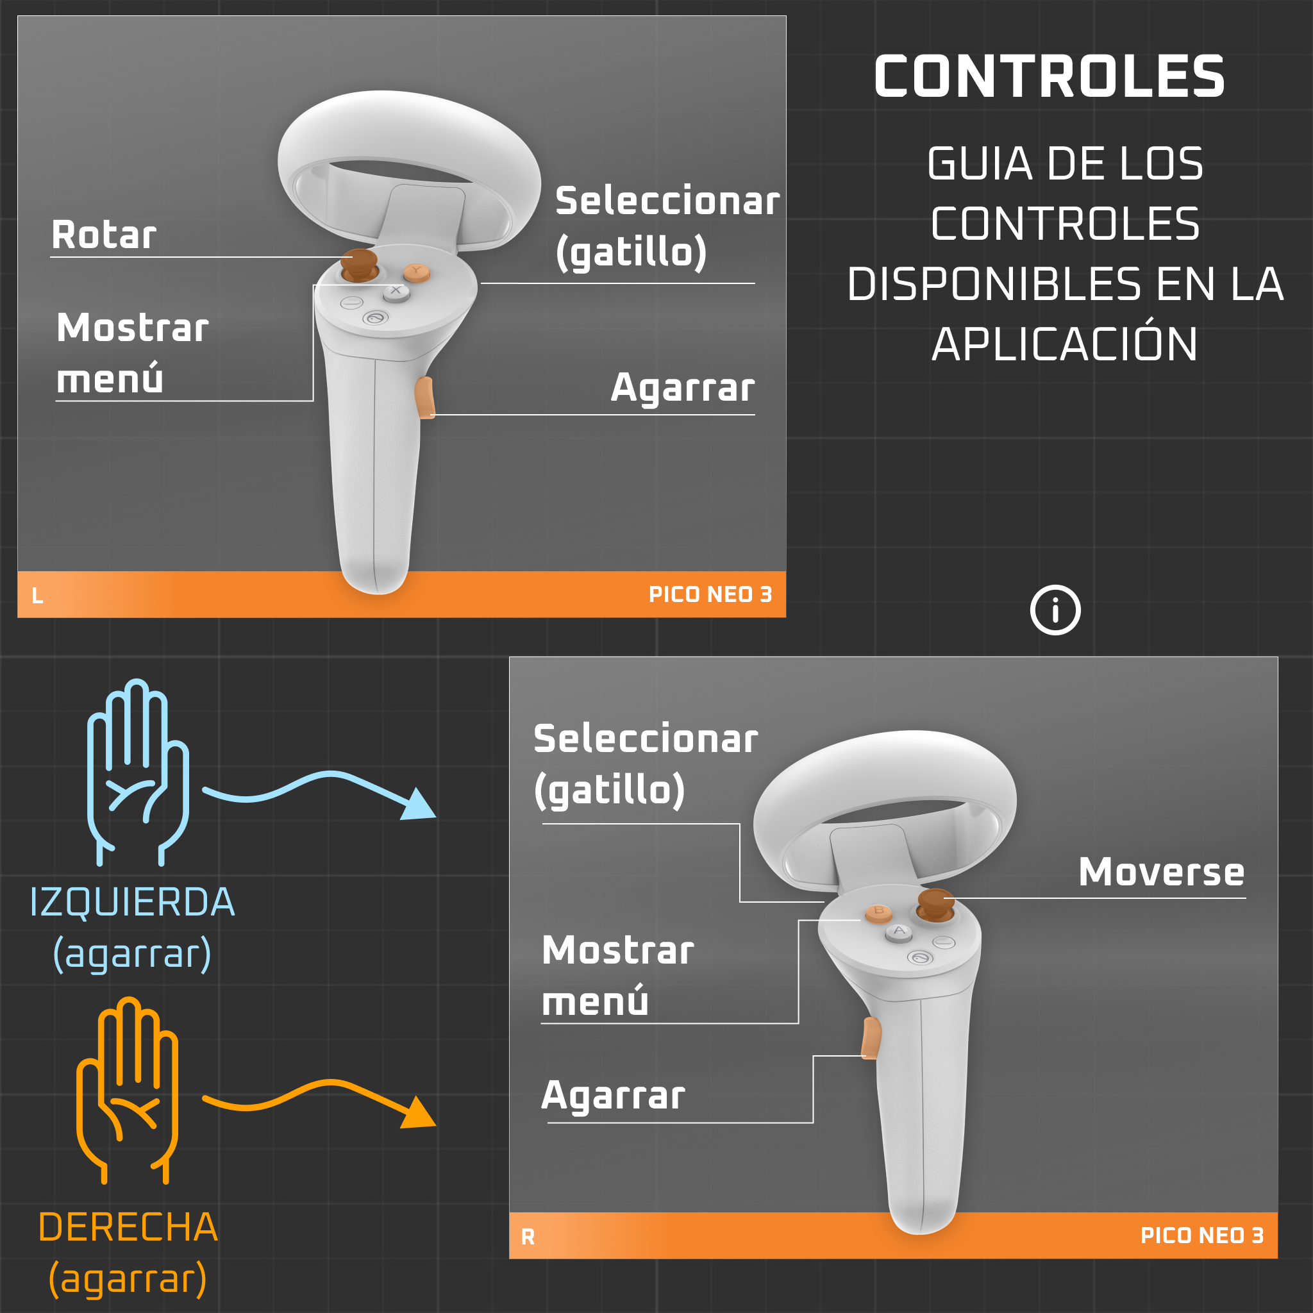
APP Controls

Slide 8
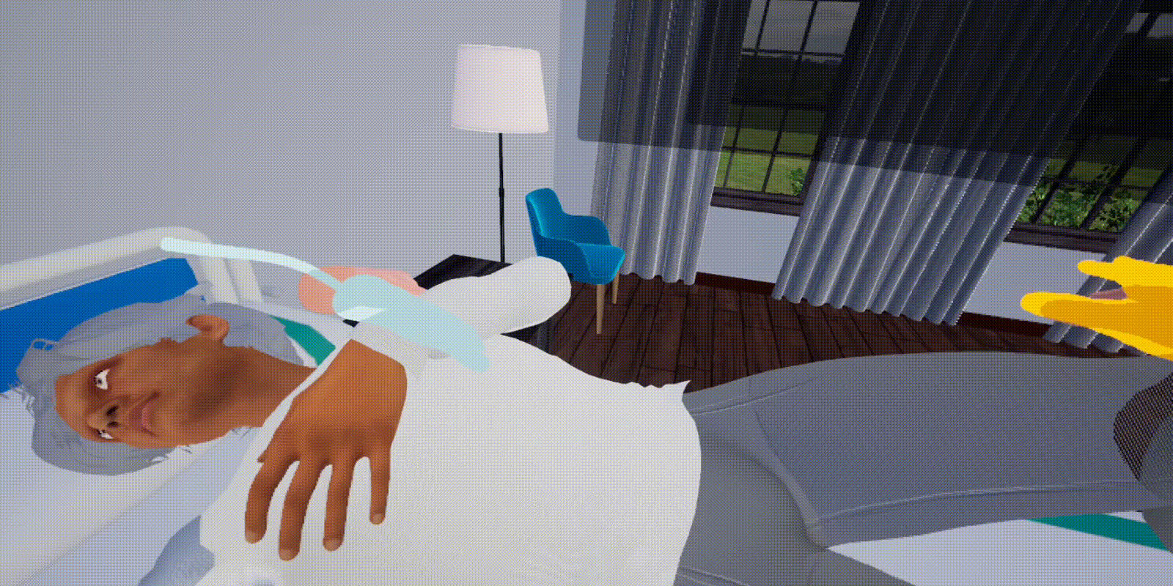
APP Controls
TELEPORT: right joystick
AGARRAR: Grip button

Slide 9
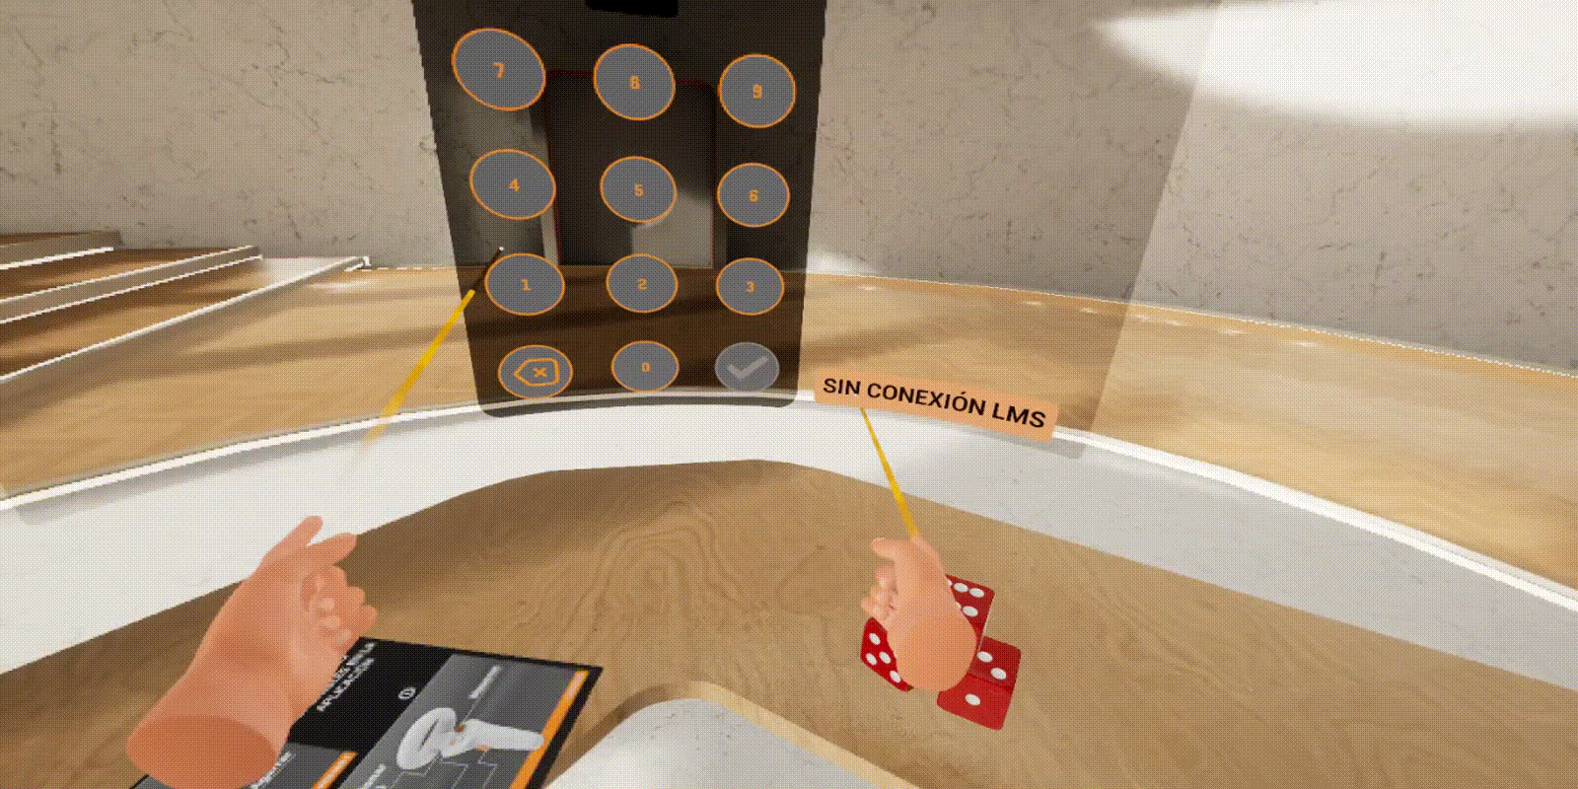
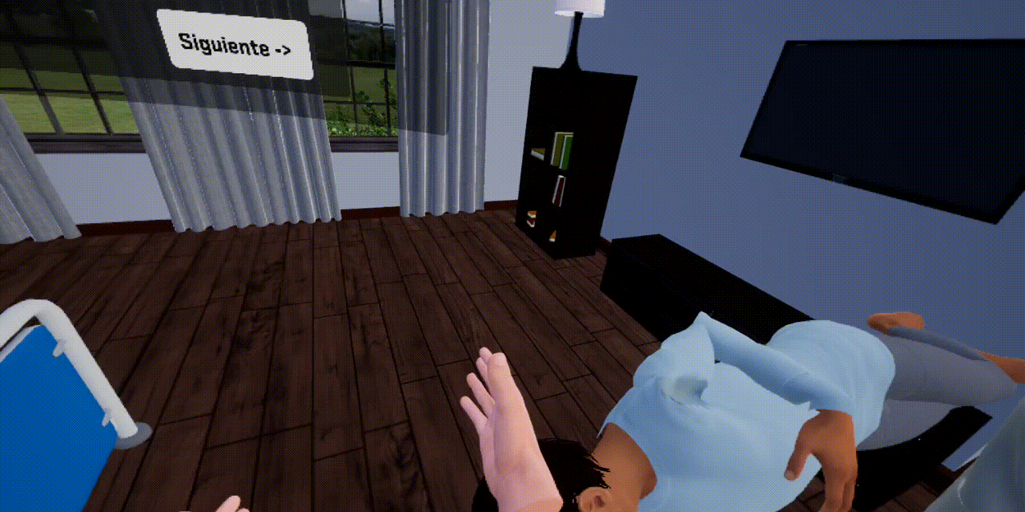
APP Controls
Interact UI: triggers
External menu: B/Y menu

Slide 10
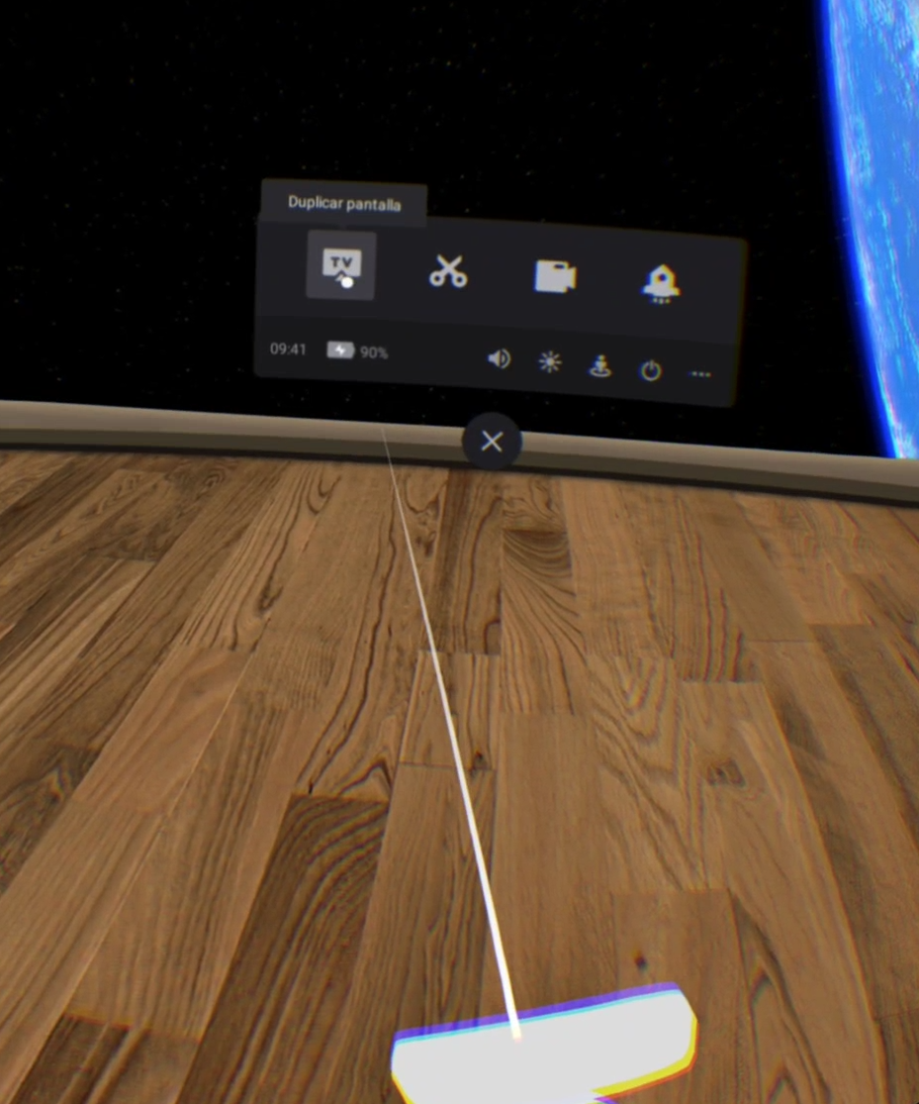
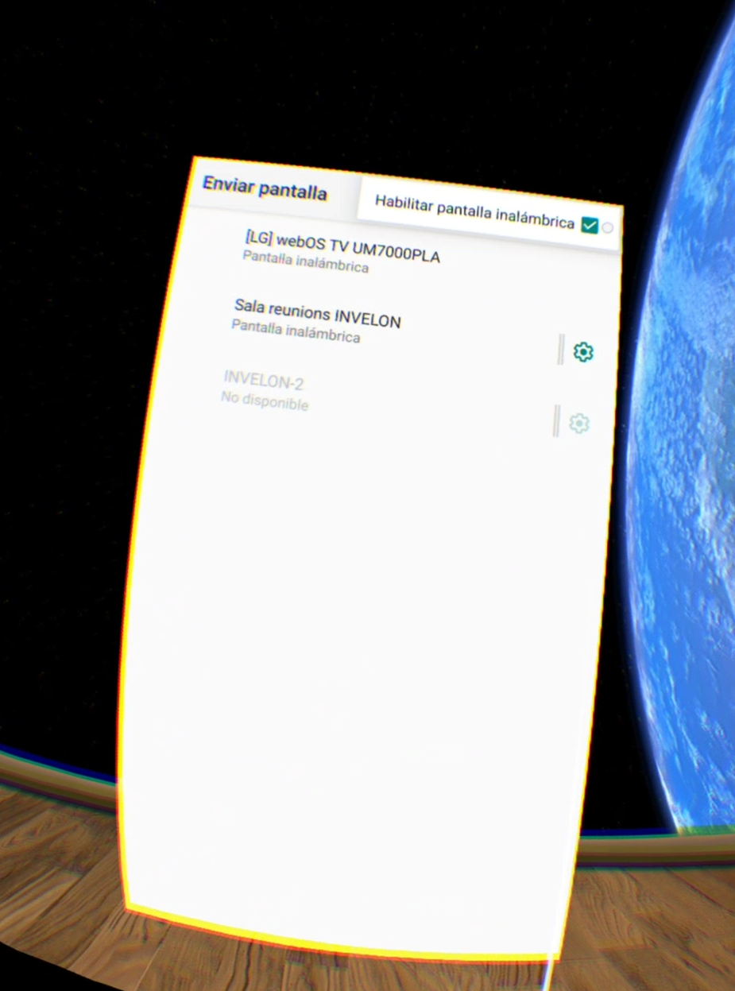
Screen cast
Press pico button in controller to access settings men
Press “cast to tv” option and make sure screen cast is enabled in top right corner options drop down.

Slide 11
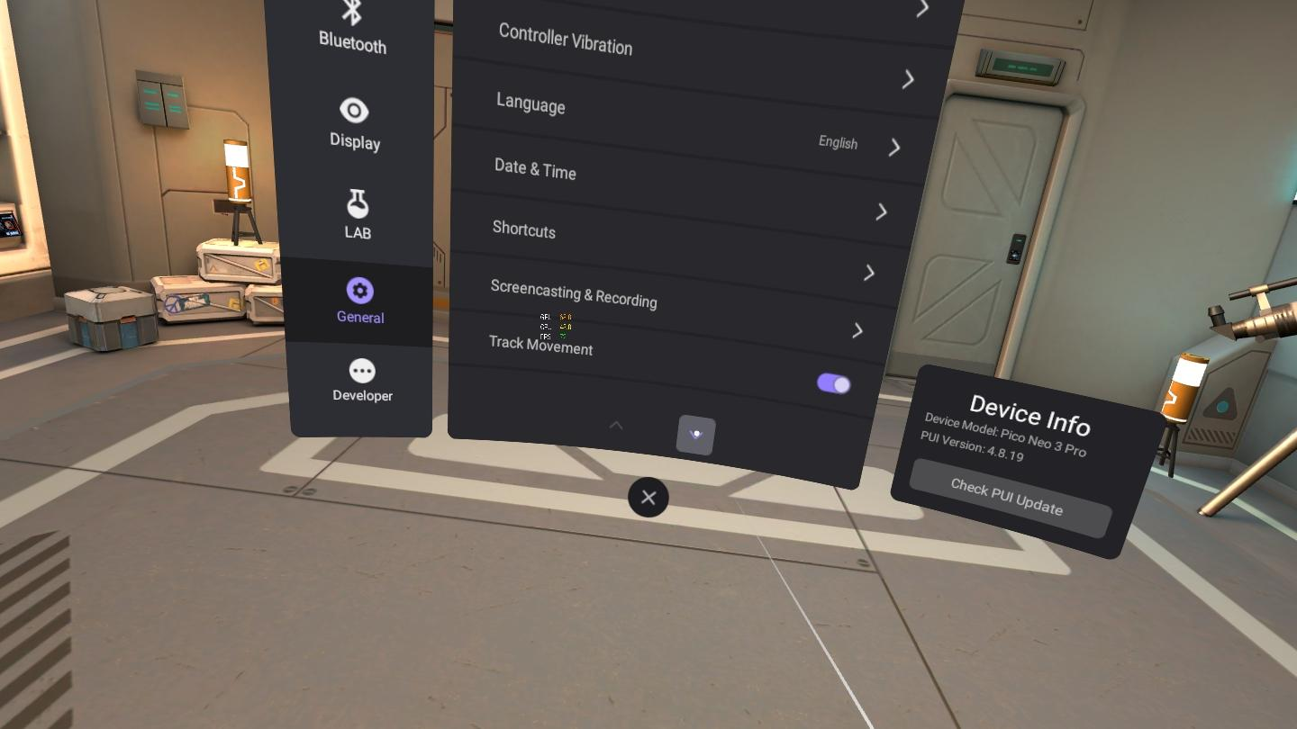
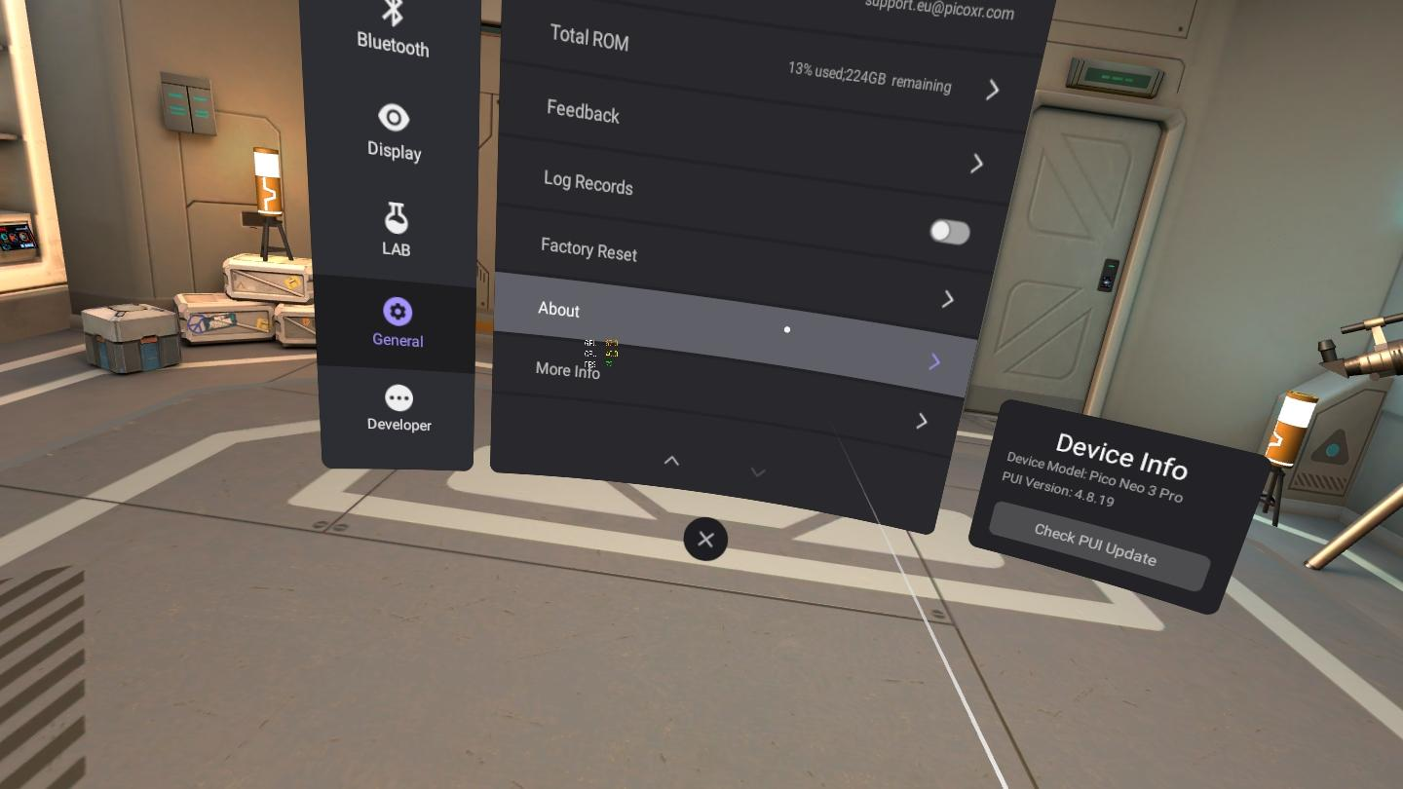
Developer mode
Go to General Settings > About -> Click 5 times on Software Version text

Slide 12
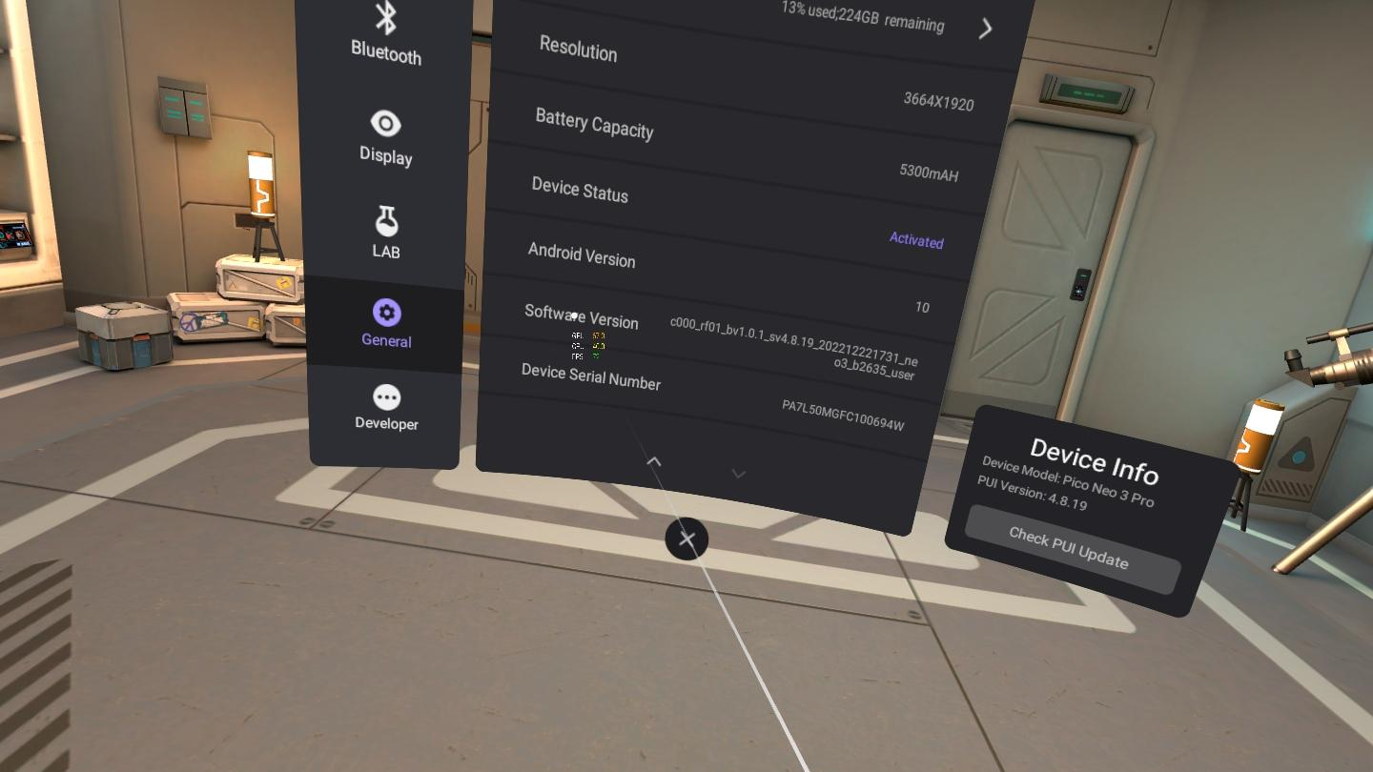
Developer mode
Go to General Settings > About -> Click 5 times on Software Version text

Slide 13
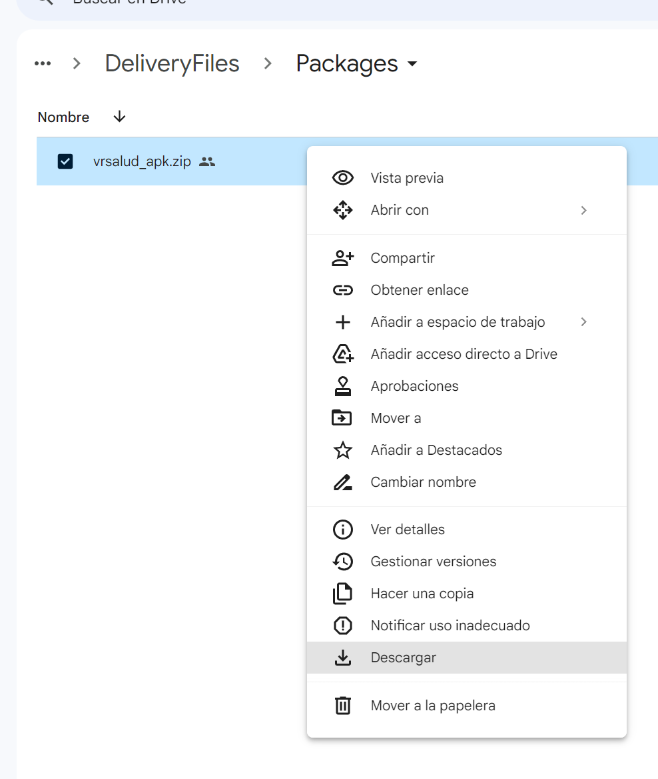
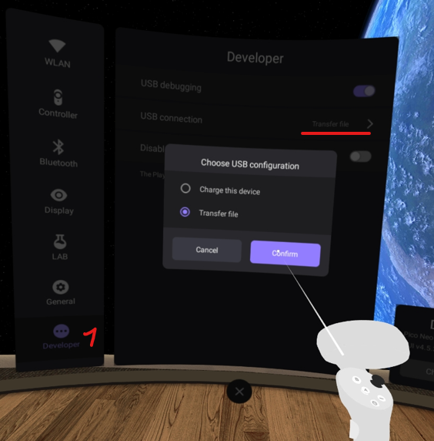
Reinstall
Download files from drive
Connect pico device via usb to pc and set usb settings to transfer file

Slide 14
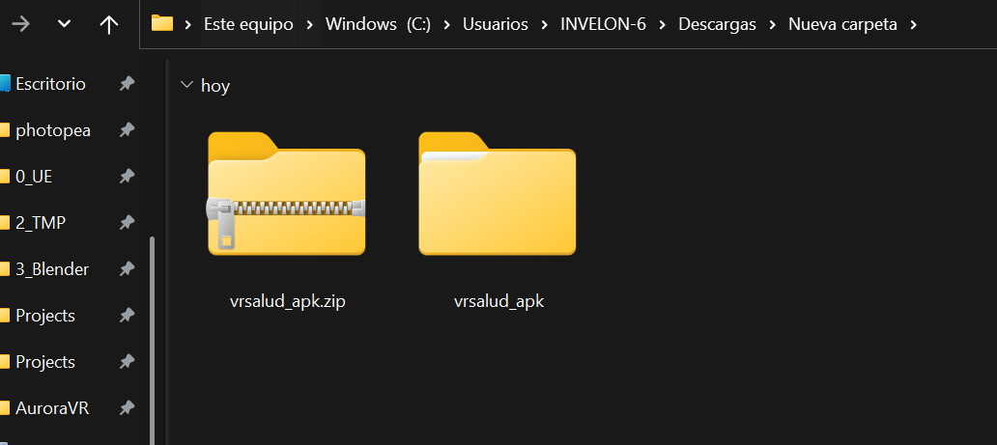
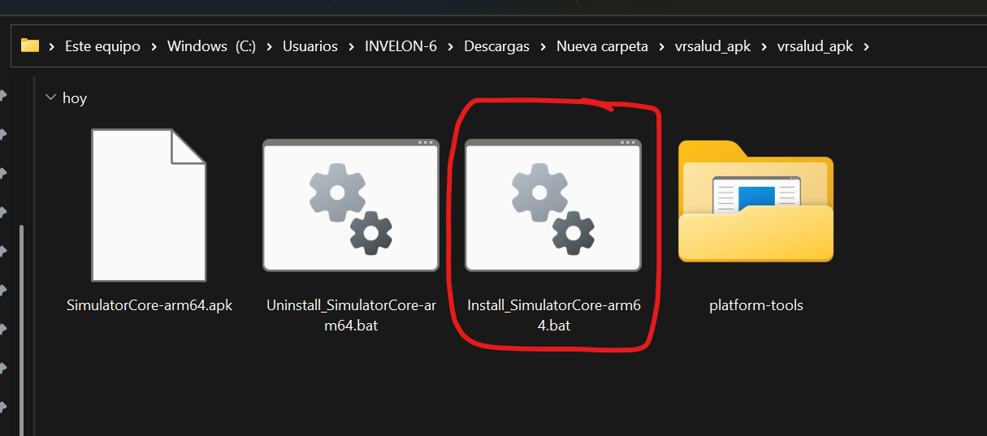
Reinstall
Verify device are properly connected, then execute install.bat

Slide 15
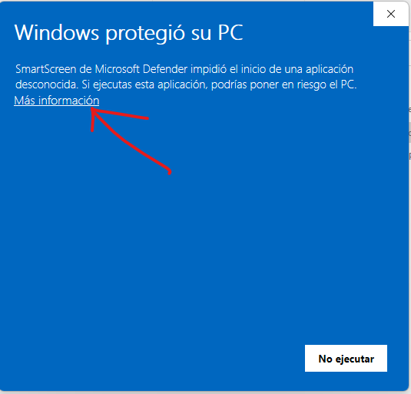
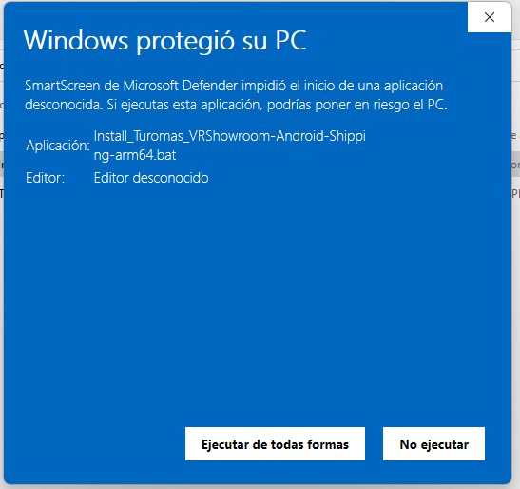
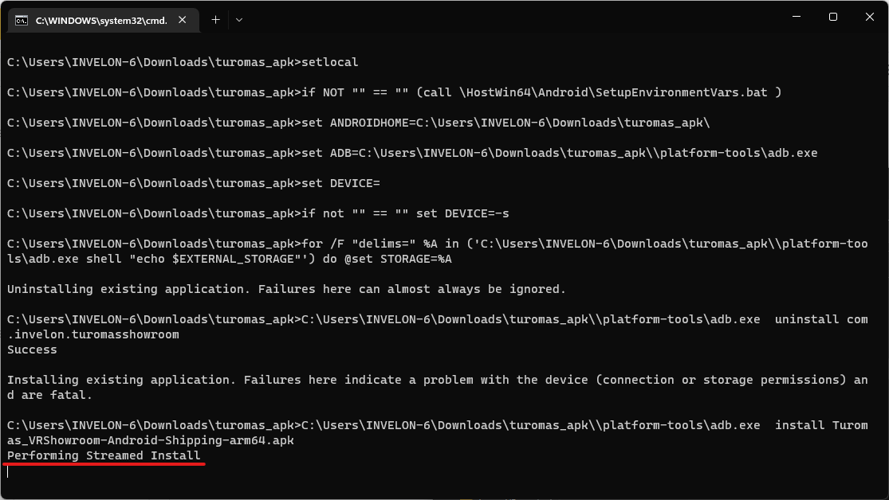
Reinstall
Allow windows to execute custom .bat files

Slide 16
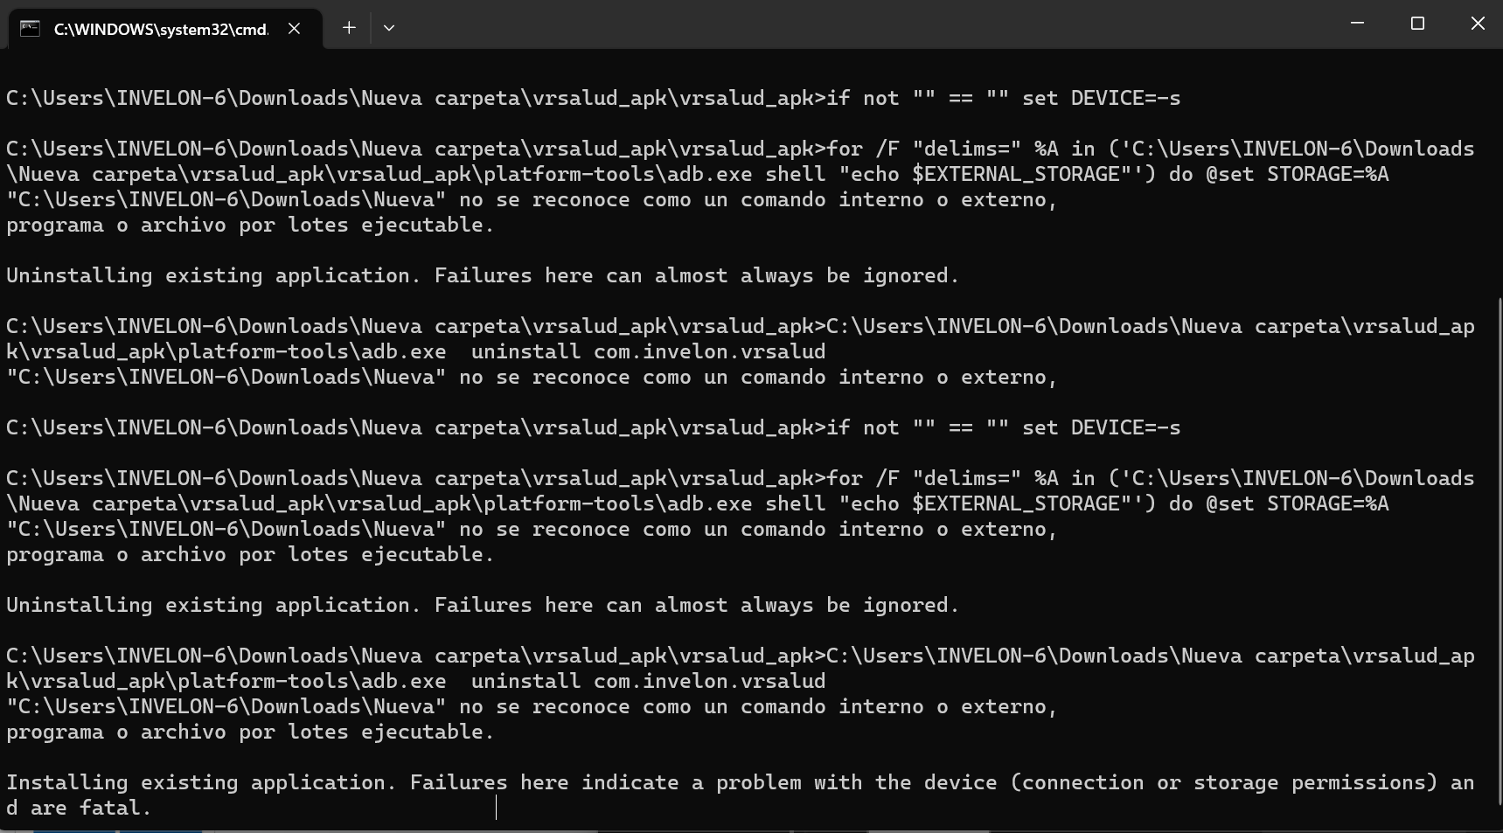
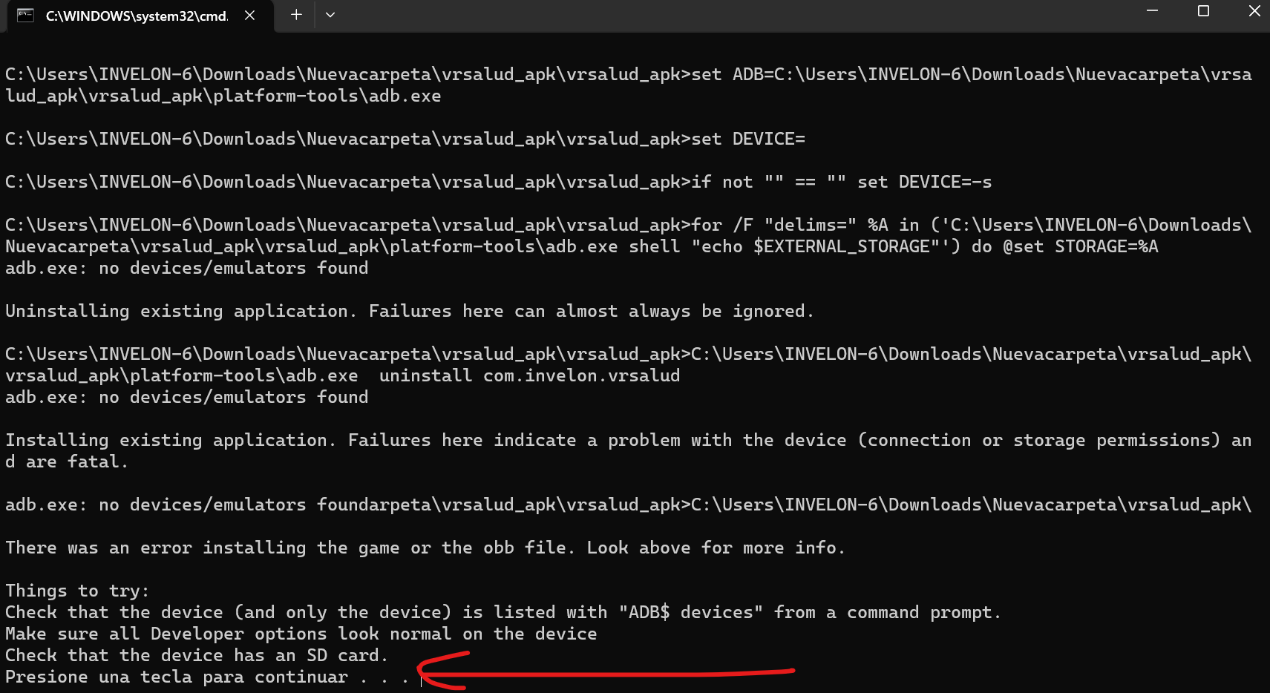
TROUBLESHOOTING
La ruta tiene algun espacio en algun nombre de la carpeta
Pc does not detect pico:
check usb cable is well connected
check pico are on
check pico are in transfer file mode

Slide 17
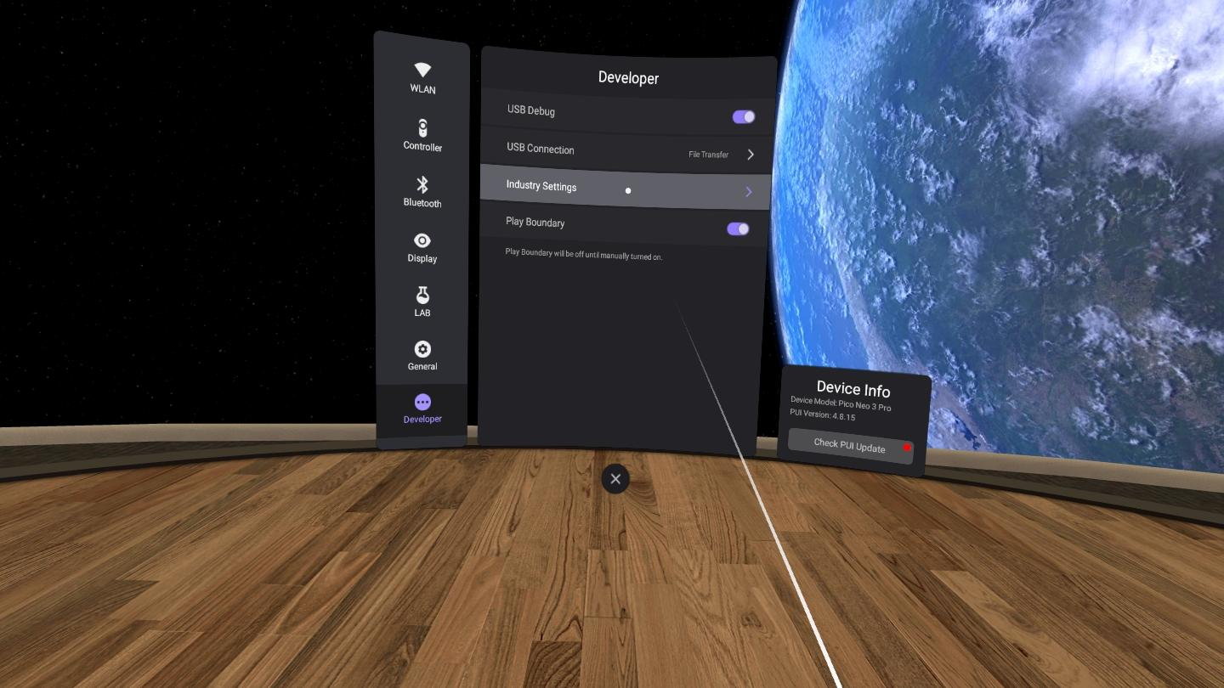
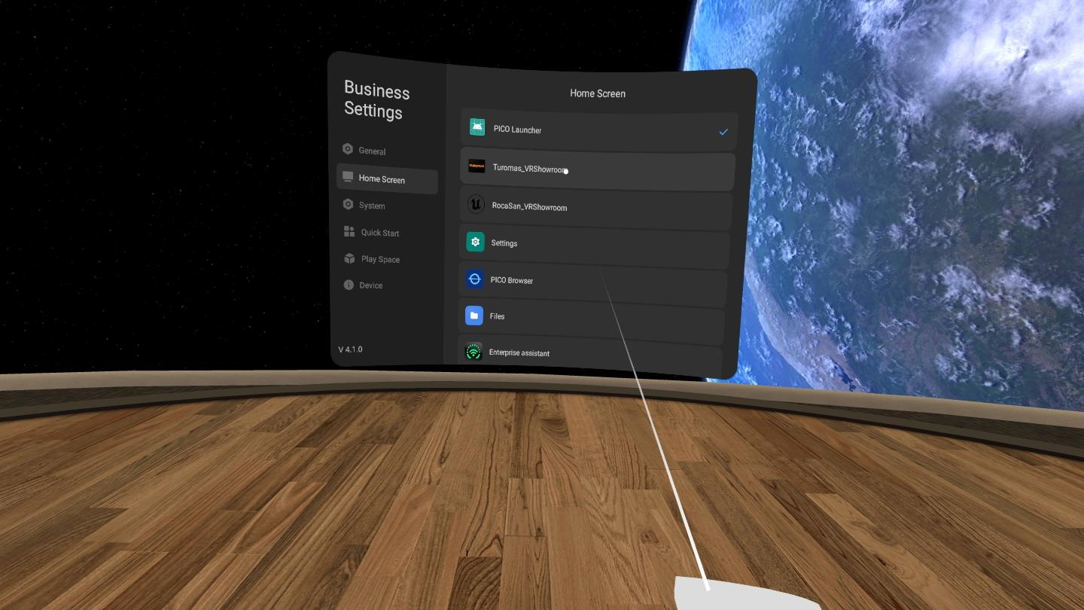
Kiosk mode (default app on start)
Press pico button to access developer settings

Slide 18
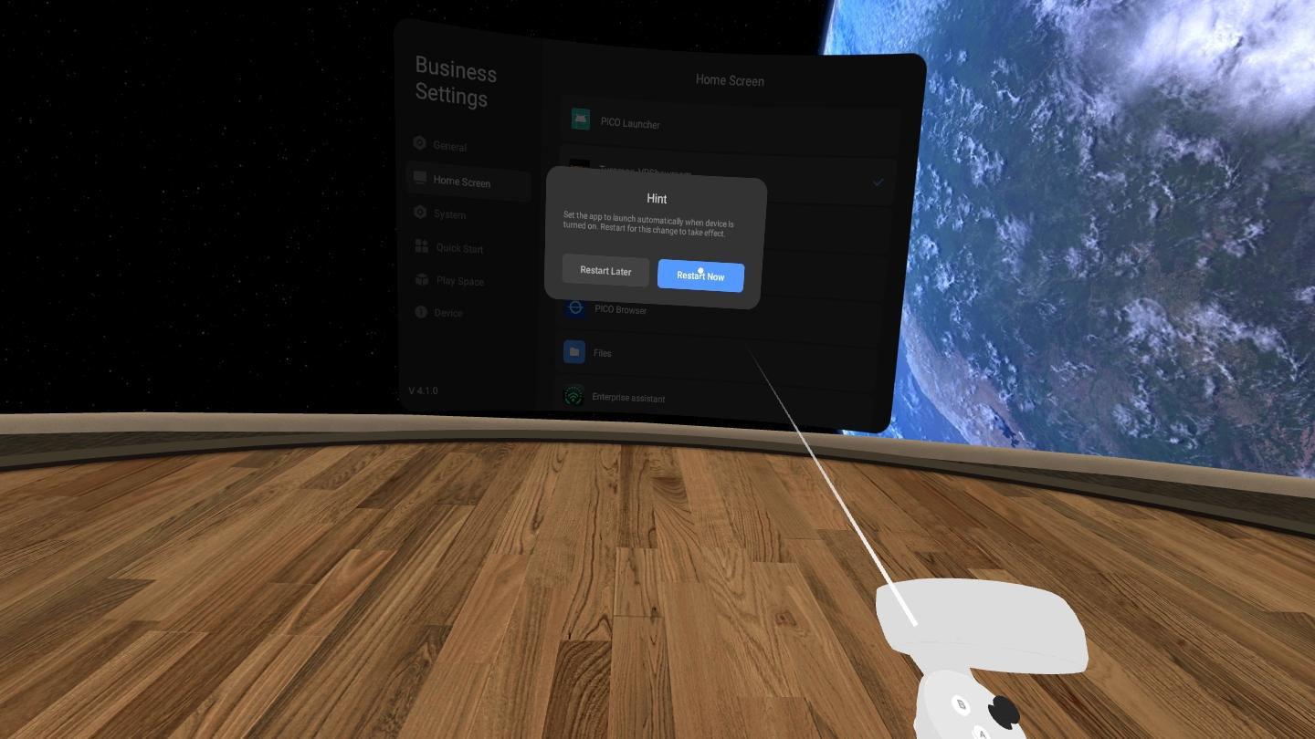
Kiosk mode (default app on start)

